Slide 1
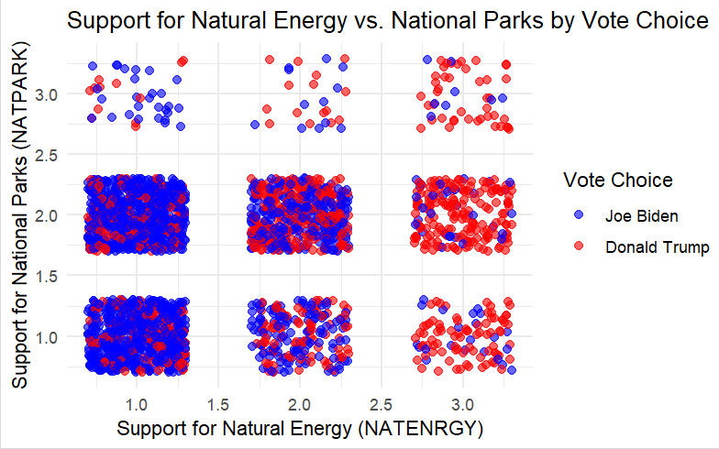
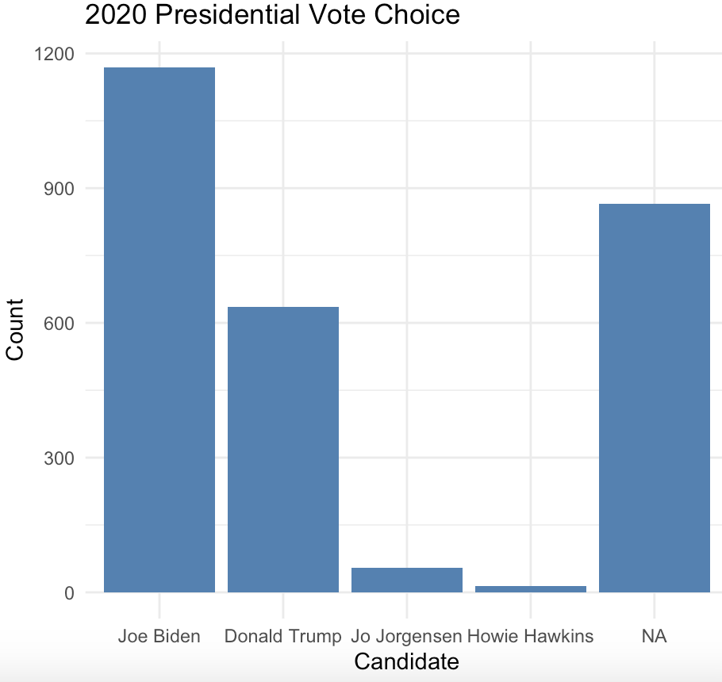
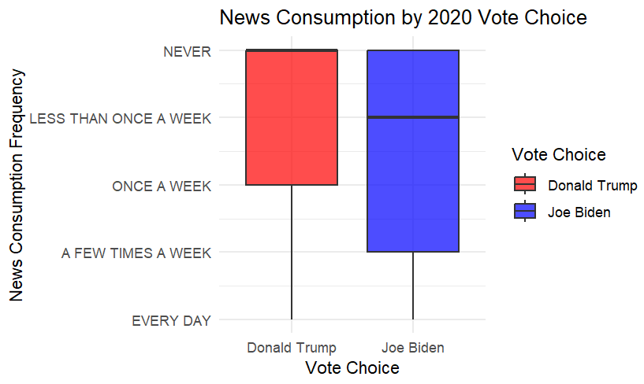
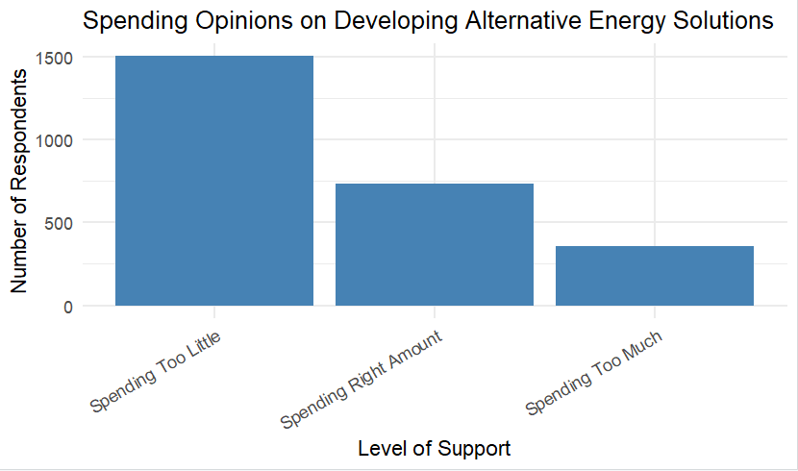
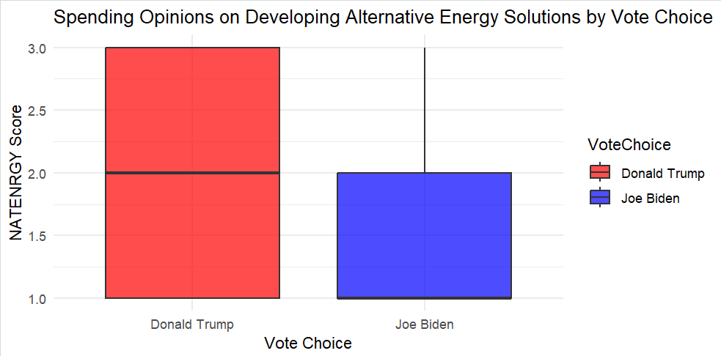
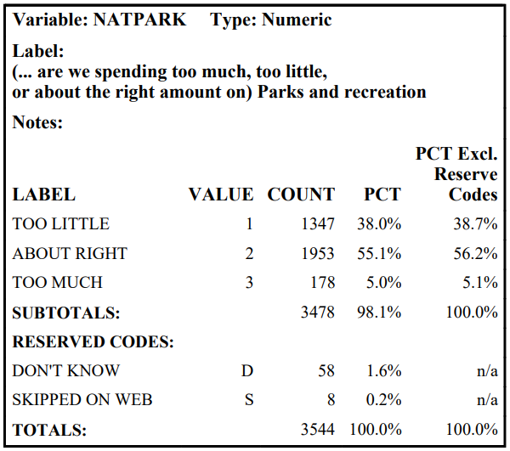
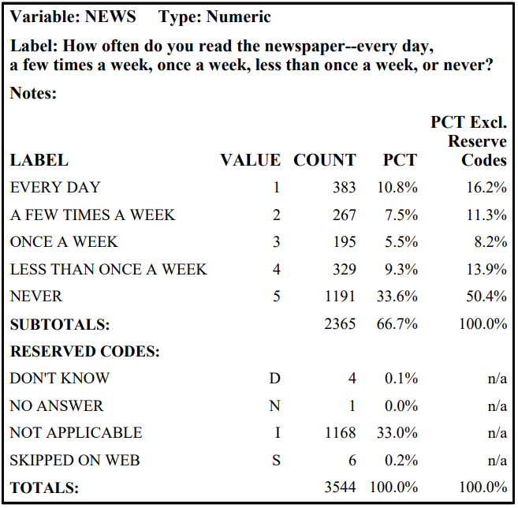
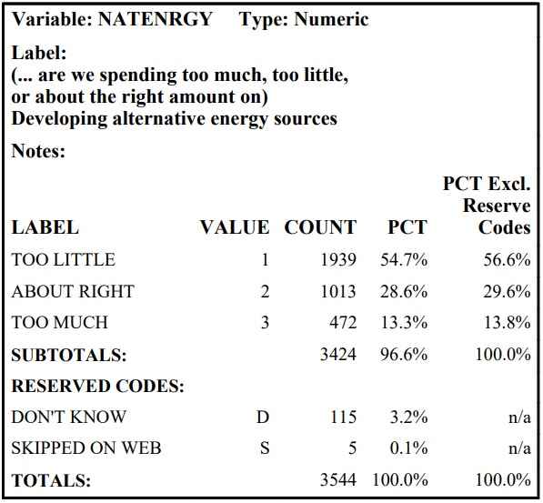


POLITICAL PARTY PREFERENCE AND ENVIRONMENTAL SPENDING TRENDS
MARIST SCHOOL OF COMPUTER SCIENCE AND MATHEMATICS
VICTORIA IUZZOLINO, EMILY LIGUORI, TRISTAN WISTUBA, DR. REZA SADEGHI
Introduction
Data Analysis
Results
This project investigates the relation between vote choice and environmental spending trends, focusing on how voting behavior, news consumption, opinions on spending for recreational services, and alternative energy sources influence spending prerogatives. Our research question examines whether political party preferences influence the public’s prioritization of environmental spending and how additional factors, including news consumption and spending for recreational and alternative energy sources, contribute to these preferences.
The bar chart for the PRES20 (B) variable shows survey participant voting choices in the 2020 U.S. presidential election. The N/A bar column represents respondents who did not vote or did not disclose who they voted for.
The boxplot comparing PRES20 and NEWS (C) variables shows the relationship between frequency of news consumption and voting choice in the 2020 presidential election. The majority of respondents who consumed news more frequently voted for President Biden, followed by President Trump.
The boxplot comparing PRES20 and NATENRGY (D) variables shows the relationship between spending opinions relating to developing alternative energy solutions and voting choice in the 2020 presidential election. NATENRGY score values are based on the 2022 GSS File Codebook (see References section.)
According to the scatter plot comparing NATENRGY and NATPARK variables, most respondents believe that the U.S government is spending too little on developing alternative energy solutions, while few participants believe that the U.S is spending too much on national parks. NATENRGY and NATPARK score values on the scatter plot are based on the 2022 GSS File Codebook (see References section.) However, more participants that voted for President Trump believe that the U.S is spending too much on natural energy and national parks, whereas more participants that voted for President Biden believe that the U.S is spending too little on natural energy and national parks.
CHI-SQUARED TEST RESULTS:
(PRES20) and (NEWS): Chi-squared: 50.12
P-value: 0 → Null hypothesis is rejected
(PRES20) and (NATENRGY): Chi-squared: 568.14
P-value: 0 → Null hypothesis is rejected
(PRES20) and (NATPARK): Chi-Squared: 53.99
P-value: 0 → Null hypothesis is rejected
(NEWS) and (NATENRGY): Chi-Squared: 14.70
P-value: 0.0652 → Null hypothesis is retained
(NEWS) and (NATPARK): Chi-Squared: 12.53
P-value: 0.1291 → Null hypothesis is retained
(NATENRGY) and (NATPARK): Chi-Squared: 209.11
P-value: 0 → Null hypothesis is rejected
E
Methods
Using data from the 2022 General Social Survey (GSS) and RStudio software, our team conducted descriptive statistical analysis, bivariate analysis, and chi-squared tests to analyze environmental spending data and examine how it relates to vote choice.
Four variables were analyzed:
Voting behavior in the 2020 U.S. presidential election (PRES20)
Frequency of newspaper readings (NEWS)
Opinions on government spending for parks and recreation (NATPARK)
Views on spending for alternative energy sources (NATENRGY)
Null Hypothesis: Vote choice has no significant influence on beliefs pertaining to environmental spending initiatives and preferences.
Alternative Hypothesis: Vote choice has a significant influence on beliefs pertaining to environmental spending initiatives and preferences.
B
C
Conclusion
In conclusion, there is a relation between vote choice and spending opinions on developing alternative energy solutions. There is also a relation between vote choice and spending opinions on government spending for national parks. Additionally, there is a relation between news consumption frequency and vote choice. Most respondents who believe that the U.S government is spending too little on developing alternative energy solutions also believe that the U.S government is spending too little on national parks and recreation. Few participants believe that the U.S government is spending too much on national parks, regardless of vote choice.
A
D
References
Davern M, Bautista R, Freese J, Herd P, Morgan SL. General Social Survey 1972–2022. Chicago (IL): NORC at the University of Chicago; 2024 cited 2025 Apr 17. https://gss.norc.org/content/dam/gss/get-documentation/pdf/codebook/GSS%202022%20Codebook.pdf
Pacca, L., Curzi, D., Rausser, G., & Olper, A. (2021). The Role of Party Affiliation, Lobbying, and Electoral Incentives in Decentralized US State Support of the Environment. Journal of the Association of Environmental and Resource Economists, 8(3), 617–653. https://doi.org/10.1086/711583
McCright, A. M., Xiao, C., & Dunlap, R. E. (2014). Political polarization on support for government spending on environmental protection in the USA, 1974–2012. Social Science Research, 48, 251–260. https://doi.org/10.1016/j.ssresearch.2014.06.008
GitHub Repository Address:
Data-220-112-Analyzing-environmental-spending-trends-Ecotrackers
(36” x 48” template)
Notes:
Notes included here

Slide 2
Introduction
This project investigates the relation between vote choice and environmental spending trends.
Focus on how voting behavior, news consumption, opinions on spending for recreational services, and alternative energy sources influence spending prerogatives.
Does political party affiliation influence environmental spending priorities and preferences and what role do voting behavior, consumption of news, opinions on spending for parks and recreational services, and views on spending for alternative energy sources play in shaping these spending prerogatives?
1
Notes:
-Add email on poster
-Explain statistical analyses

Slide 3
Methods
Data Set: 2022 General Social Survey (GSS)
Software: RStudio
Four Key Variables Used:
Voting Choice in the 2020 U.S Election (PRES20)
News Consumption (NEWS)
Opinions on Spending for National Parks (NATPARK)
Opinions on Spending for Alternative Energy (NATENRGY)
2

Slide 4

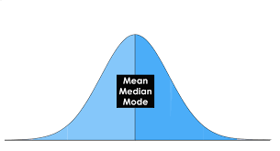
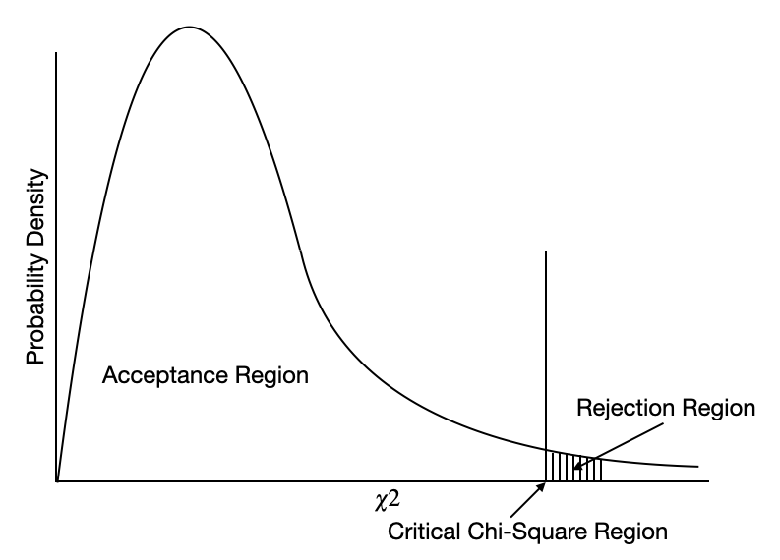
Statistical Tests Used
Bivariate Analysis
Descriptive Statistics
Chi-Square Test
3
Notes:
Descriptive Statistics: summarizes and describes the main features of the data set
-mean, median, mode, standard deviation, frequency, percentage
-gives us a snapshot of the data, typical values, how spread out it is, overall patterns
Bivariate Analysis:
-examines the relationship between two variables
-t-tests, scatterplots, chi-square tests
-helps to determine if and how two variables are related
Chi-Square Test:
-tests whether there’s a statistically significant relationship between two categorical variables
-tells you if observed differences are likely due to chance or if there’s a meaningful association

Slide 5
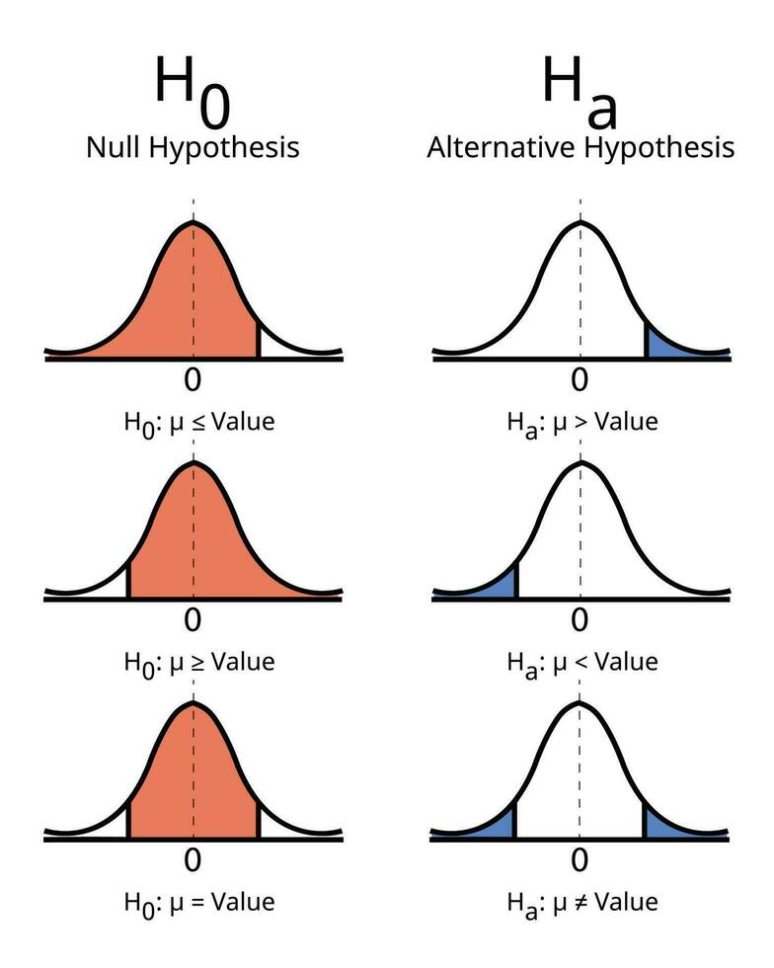
Null & Alternative Hypotheses
Null Hypothesis:
Vote choice has no significant influence on beliefs pertaining to environmental spending initiatives and preferences.
Alternative Hypothesis:
Vote choice has a significant influence on beliefs pertaining to environmental spending initiatives and preferences.
4

Slide 6
Descriptive statistics
PRES20:
Min. 1st Qu. Median Mean 3rd Qu. Max. NA's
1.000 1.000 1.000 1.428 2.000 4.000 1352
Interpretation: These statistical values summarize the distribution variable PRES20. The distribution is skewed right based on the minimum, 1st quartile, median, and 3rd quartile, indicating that most values are concentrated around 1.0 and 2.0. The median (1.000) is slightly lower than the mean (1.428), suggesting a right-skewed tendency. The upper limit of the data is shown by the maximum value of 4.000, while a substantial amount of incomplete data is indicated by the 1,325 missing values (NAs).
NEWS:
Min. 1st Qu. Median Mean 3rd Qu. Max. NA's
1.000 2.000 4.000 3.717 5.000 5.000 1397
Interpretation: These statistical values summarize the distribution variable of NEWS. The distribution appears slightly left-skewed based on the minimum, first quartile, median, and third quartile, suggesting that most values are concentrated around 2.000 and 4.000. The mean (3.717) is slightly lower than the median (4.000), reinforcing this left-skewed tendency.
5

Slide 7
Descriptive statistics
NATPARK:
Min. 1st Qu. Median Mean 3rd Qu. Max. NA's
1.000 1.000 2.000 1.667 2.000 3.000 73
Interpretation: These statistical values summarize the variables of NATPARK. The minimum value is 1.000, and the maximum is 3.000, indicating a relatively small range. The 1st quartile (1.000) and median (2.000) suggest that at least half of the data is concentrated between 1.000 and 2.000. The mean (1.667) is slightly lower than the median, which suggests a slight left skew in the distribution. The 3rd quartile (2.000) indicates that most values do not exceed 2.000, with only a few reaching 3.000. There are 73 missing values (NAs) in the dataset.
NATENRGY:
Min 1st Qu. Median Mean 3rd Qu. Max NA’S
1.000 1.000 1.000 1.561 2.000 3.000 123
Interpretation: These statistical values summarize the variables of NATENRGY. The minimum (1.000), 1st quartile (1.000), and median (1.000) indicate that a large portion of the data is concentrated at the lowest value. The mean (1.561) is slightly higher than the median, suggesting a slight right skew in the distribution. The 3rd quartile (2.000) and maximum (3.000) show that while most values are low, a portion extends to higher numbers. Additionally, there are 123 missing values (NAs) in the dataset.
6

Slide 8
Data Analysis
This bar chart shows opinions on alternative energy spending by survey respondents (A).
Without political party consideration, there is a general consensus that majority of survey respondents believe that too little is being spent on alternative energy sources.
7

Slide 9
Data Analysis
This bar chart shows survey respondents voting choices in the 2020 U.S. presidential election (B).
The N/A bar column represents survey respondents who did not vote or did not disclose who they voted for.
President Biden received the highest number of votes among survey respondents, followed by President Trump.
8
Notes:
This distribution provides more context for analyzing how political affiliation correlates with opinions on environmental spending

Slide 10
Data Analysis
This boxplot compares news consumption to survey respondents voting choices in the 2020 U.S. presidential election (C).
The majority of survey respondents who consumed news more frequently voted for President Biden followed by President Trump.
The spread for respondents that voted for President Trump is more varied with more outliers, indicating a wider range of news consumption patterns.
9
Notes:
This supports the idea that news consumption varies by political affiliation

Slide 11
Data Analysis
This boxplot compares opinions on spending for alternative energy sources to survey respondents voting choices in the 2020 U.S. presidential election (D).
Respondents that voted for President Trump tend to believe that the U.S. spends too much on alternative energy sources, with President Biden voters believing the U.S. spends too little.
There is more variability in data for respondents who voted for President Trump.
10
Notes:
This supports our hypothesis that vote choice influences opinions on spending for alternative energy sources and overall environmental spending
Trump voters are less in favor
Biden voters are more in favor
This is a clear visual representation of the polarization in environmental priorities based on political party preference.

Slide 12
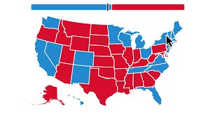
Overall, these visualizations highlight a consistent pattern: political affiliation is a major predictor of public opinion on environmental spending priorities.
There is a clear divide in environmental spending priorities based on political party preferences.
11

Slide 13
Results
These scatterplots compared opinions on spending for alternative energy sources and national park and recreational services (E).
Most survey respondents believe that the U.S government is spending too little on developing alternative energy solutions, while few participants believe that the U.S is spending too much on national parks.
Respondents that voted for President Trump believe that the U.S is spending too much on natural energy and national parks, whereas respondents that voted for President Biden believe that the U.S is spending too little on natural energy and national parks.
Environmental spending views are consistent between both political parties
12
Notes:
Crucial for visualizing how these spending opinions overlap
Shows not just a relationship, but how people are grouped together
Confirms statistical relationships found with chi-square tests
More dense plots = vote choice more likely influences environmental spending

Slide 14
Chi-square tests are used to determine whether two categorical variables are related to one another.
PRES20 & NATENRGY variables have the strongest relationship, highly statistically significant = voting choice strongly predicts opinion on spending for alternative energy.
Both NEWS & NATENRGY and NEWS & NATPARK variables are not statistically significant = news consumption does not strongly predict opinions on spending.
Both NATENRGY & NATPARK variables are strongly related, individuals who support/disapprove of spending for alternative energy sources also tend to have the same opinion on spending for national parks and recreational services.
Political party affiliation (PRES20) was the most consistent and a strong predictor across each variable
Chi- Squared Tests
CHI-SQUARED TEST RESULTS:
(PRES20) and (NEWS): Chi-squared: 50.12
P-value: 0 → Null hypothesis is rejected
(PRES20) and (NATENRGY): Chi-squared: 568.14
P-value: 0 → Null hypothesis is rejected
(PRES20) and (NATPARK): Chi-Squared: 53.99
P-value: 0 → Null hypothesis is rejected
(NEWS) and (NATENRGY): Chi-Squared: 14.70
P-value: 0.0652 → Null hypothesis is retained
(NEWS) and (NATPARK): Chi-Squared: 12.53
P-value: 0.1291 → Null hypothesis is retained
(NATENRGY) and (NATPARK): Chi-Squared: 209.11
P-value: 0 → Null hypothesis is rejected
13
Notes:
Compares NATENRGY and NATPARK spending opinions; crucial for visualizing how these spending opinions overlap
Shows not just that there is a relationship, but how people are grouped
Confirm statistical relationships found with chi-square tests
More dense plots = vote choice more likely influences environmental spending

Slide 15
Why are Chi-Square Tests Important in our Research?
These tests are important because they test the statistical significance of the data being analyzed. This allows for us to test the following:
Does political party affiliation influence environmental spending priorities and preferences and what role do voting behavior, consumption of news, opinions on spending for parks and recreational services, and views on spending for alternative energy sources play in shaping these spending prerogatives?
The results from our chi-squared tests indicate that the statistical significance of most of our variable groups is enough to reject our null hypothesis. This means that for most variables, there is a significant relation between them.
Therefore, voting choice does influence views on environmental spending. News consumption with NATENRGY and NATPARK showed a weaker relationship.
14

Slide 16
Conclusion
There is a strong relation between voting choice and spending opinions on developing alternative energy solutions (χ² = 568.14, p < 0.05).
Biden voters tend to believe that the U.S. is spending too little, while Trump voters believe that the U.S. is spending too much.
There is also a relation between vote choice and spending opinions on government spending for national parks (χ² = 53.99, p < 0.05).
Again, Biden voters tend to believe that the U.S. is spending too little, while most Trump voters believe that the U.S. is spending too much, yet responses tend to be more varied.
Additionally, there is a relation between news consumption frequency and vote choice, although weaker (χ² = 50.12, p < 0.05).
News consumption may be associated with political preference but less directly predicts views on environmental spending
Most respondents who believe that the U.S government is spending too little/too much on developing alternative energy solutions also believe that the U.S government is spending too little/too much on national parks and recreation (χ² = 209.11, p < 0.05)..
Few participants believe that the U.S government is spending too much on national parks, regardless of vote choice, highly the majority support for park funding over alternative energy sources.
15

Slide 17
References
Davern M, Bautista R, Freese J, Herd P, Morgan SL. General Social Survey 1972–2022. Chicago (IL): NORC at the University of Chicago; 2024 cited 2025 Apr 17. https://gss.norc.org/content/dam/gss/get-documentation/pdf/codebook/GSS%202022%20Codebook.pdf
Pacca, L., Curzi, D., Rausser, G., & Olper, A. (2021). The Role of Party Affiliation, Lobbying, and Electoral Incentives in Decentralized US State Support of the Environment. Journal of the Association of Environmental and Resource Economists, 8(3), 617–653. https://doi.org/10.1086/711583
McCright, A. M., Xiao, C., & Dunlap, R. E. (2014). Political polarization on support for government spending on environmental protection in the USA, 1974–2012. Social Science Research, 48, 251–260. https://doi.org/10.1016/j.ssresearch.2014.06.008
GitHub Repository Address:
Data-220-112-Analyzing-environmental-spending-trends-Ecotrackers
16

Slide 18
Thank You!
If you have any questions or are interested in learning more about our project, feel free to reach out to us via email!
Email: emily.liguori1@marist.edu, victoria.iuzzolino1@marist.edu, tristan.wistuba1@marist.edu
18

